Slide 1
Understanding Food Partnership Impact
Callum Etches – Impact Lead, Sustainable Food Places

Slide 2
Session outline
Part 1: Intro to MEL and the impact measurement process
MEL Jargon busting
Rainbow Framework – an impact measurement process
Theories of change
Part 2: Impact measurement for food partnerships
Overcoming the ‘dual attribution’ problem
A food partnership impact framework
Collecting partner data

Slide 3
Learning objectives
By the end of the session, you will:
Have a basic understanding of the different functions of Monitoring, Evaluation, and Learning (MEL).
Know where to go for more information on conducting MEL processes.
Understand how to create and use an impact framework to capture and communicate the value added of your partnership.

Slide 4
What is MEL?
A comprehensive approach to data collection, analysis and reporting
Monitoring: ongoing, real-time monitoring of project resources, activities and results and review of performance indicators and metrics.
Evaluation: any systematic approach to judge merit, worth or significance of an activity, by combining evidence and values.
Learning: using the results of monitoring and evaluation processes to adapt and develop our approach.
https://www.betterevaluation.org/getting-started/what-evaluation
https://policy-practice.oxfam.org/resources/a-quick-guide-to-monitoring-evaluation-accountability-and-learning-in-fragile-c-297134/
https://www.betterevaluation.org/tools-resources/what-evaluation-aea-statement

Slide 5
Different types of evaluation
When we talk about evaluation, we include evaluations that are intended to be used for different purposes:
Formative: to make improvements
Summative: to inform decisions about whether to start, continue, expand or stop an intervention.
https://www.betterevaluation.org/getting-started/what-evaluation

Slide 6
How do we ‘do’ an evaluation?
Appreciative inquiry
Beneficiary assessment
Case study
Causal link monitoring
Collaborative outcomes reporting
Contribution analysis
Critical system heuristics
Democratic evaluation
Developmental evaluation
Empowerment evaluation
Horizontal evaluation
Innovation history
Institutional histories
Most significant change
Outcome harvesting
Outcome mapping
Participatory evaluation
Participatory rural appraisal (PRA) / Participatory learning for action (PLA)
Positive deviance
Qualitative impact assessment protocol
Randomised controlled trial
Rapid evaluation
Realist evaluation
Social return on investment
Success case method
Utilisation-focused evaluation
There are a huge number of methods and approaches to conducting MEL.
What you choose depends on your unique circumstances - approaches need to be tailored to the specific nature of your activity and the objectives of the evaluation.
https://www.betterevaluation.org/methods-approaches/approaches

Slide 7
Choosing appropriate evaluation methods and processes
The Rainbow Framework:
Manage
Define
Frame
Describe
Understand Causes
Synthesise
Report and Support Use
https://www.betterevaluation.org/frameworks-guides/rainbow-framework

Slide 8
Choosing appropriate evaluation methods and processes
The Rainbow Framework:
Manage –how decisions will be made for each step of the evaluation and ensuring they are implemented well.
Define – the project and how actions are understood to contribute to impact (Theory of Change).
Frame – being clear about the boundaries of the evaluation.
Describe – collecting or retrieving data and analyzing it to answer your evaluation questions.
Understand Causes – addressing questions about cause and effect
Synthesise – bring together data to provide and overall conclusion
Report and Support Use – communicate findings, facilitate learning and adaptation.
https://www.betterevaluation.org/frameworks-guides/rainbow-framework
https://www.betterevaluation.org/methods-approaches

Slide 9
Theory of Change (ToC)
Explains how your project, programme, policy, or strategy, is understood to contribute to a chain of results that produce the intended or actual impacts.
Theory of Change Logic Model:
Activities -> Outputs ->Outcomes -> Impact
The steps to build a Theory of Change:
Agree the long-term intended impact (the big long-term change you want to see)
Map outcomes (the real changes resulting from your activities) backwards, thinking of them as necessary pre-conditions
Identify activities (the things we do - our services, products, campaigns, etc.) necessary to achieve outcomes
Identify assumptions (enablers and risks underlying your theory) to interrogate your theory. At this stage, you identify key assumptions you have made between the work delivered and the difference you want to make, and about the overall rationale and context.
Establish a timeline and plan resources
Produce a diagram and narrative
https://www.ncvo.org.uk/help-and-guidance/strategy-and-impact/strategy-and-business-planning/theory-of-change/

Slide 10
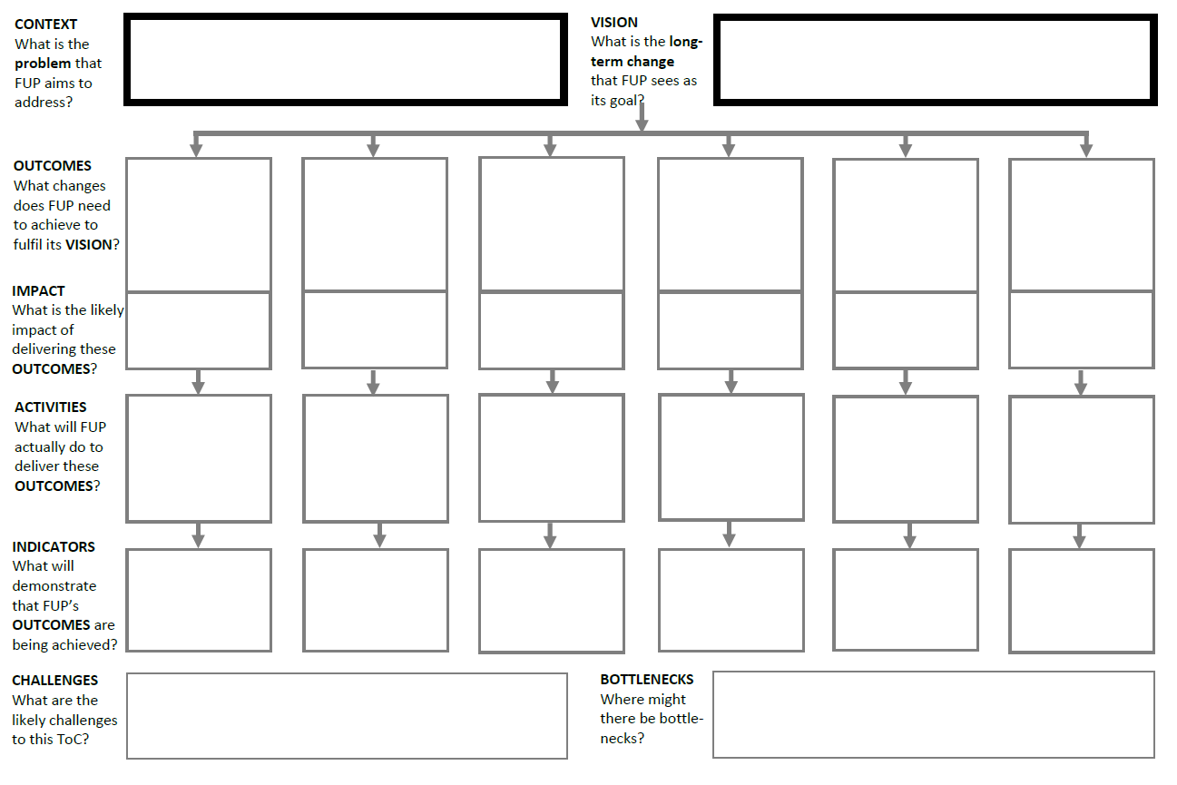
ToC Template: Logic Model

Slide 11
ToC Example: SFP

Slide 12
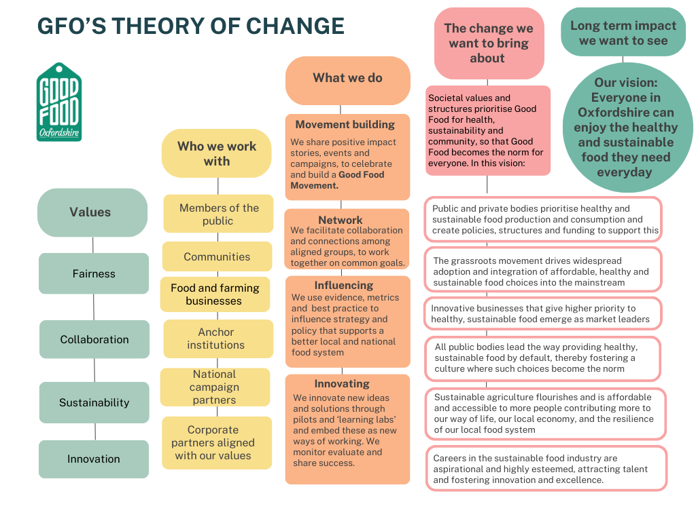
ToC Example: Good Food Oxfordshire (draft)

Slide 13
Applying MEL to the food partnership context

Slide 14
Twin Attribution Problem
Food partnerships have a particularly difficult task in documenting evidence of impact due to two specific attributes:
Working in partnership – actions taken by a range of partners involving a blurring of lines between roles and responsibilities.
Addressing systems level challenges – defined by complex feedback loops with often unpredictable dynamics making identify cause and effect very challenging.

Slide 15
Activities -> Outputs -> Outcomes -> Impact

Slide 16
What do Food Partnerships do?
Coordinate
Voice
Connect
Amplify
Share
Influence
Bridge
Convene
Platform
Deliver
Instigate
Campaign
Broker
Network

Slide 17
Food Partnership Impact Framework (activity)
Deliver – own projects and programmes, directly involving themselves in local food action.
Coordinate – action across the food system, sharing knowledge, and connecting stakeholders across sectors.
Influence – local food decision making, helping to make local food policies, strategies and actions plans more inclusive and representative. Influencing the hearts and minds of local people through campaigning and public engagement.
Instigate – mobilising funding, identifying gaps, by sharing knowledge of good practice and innovation and facilitating collaboration between stakeholders.
Amplify – by sharing and promoting the work of others, helping to build the momentum of a local good food movement.
https://collectiveimpactforum.org/resource/backbone-starter-guide-a-summary-of-major-resources-about-the-backbone/

Slide 18
What are the outputs?
Activity | Outputs
Deliver | Project impacts, partner impacts*, people reached, activities ran, food distributed, etc.
Coordinate | Connections made, cross-sectoral bridges built, partners engaged, knowledge shared, etc.
Influence | Influential contacts engaged, policies influenced, decision making processes participated in, campaigns ran, etc.
Instigate | Projects seeded, funding mobilized, ideas shared, collective actions mobilized, etc.
Amplify | Partners work platformed, campaigns engaged in, learnings shared, etc.

Slide 19
Tracking your activity and impact
Start logging your activity and impact:
Make a brief note of what you have done, when and with whom.
Keep it simple – record just enough information to capture the activity and provide the opportunity to follow up later.
Provide space for recording longer term impact of activity, as and when it happens.
Top tips(from SFP award holders):
Start this process early.
Don’t undervalue your work!

Slide 20
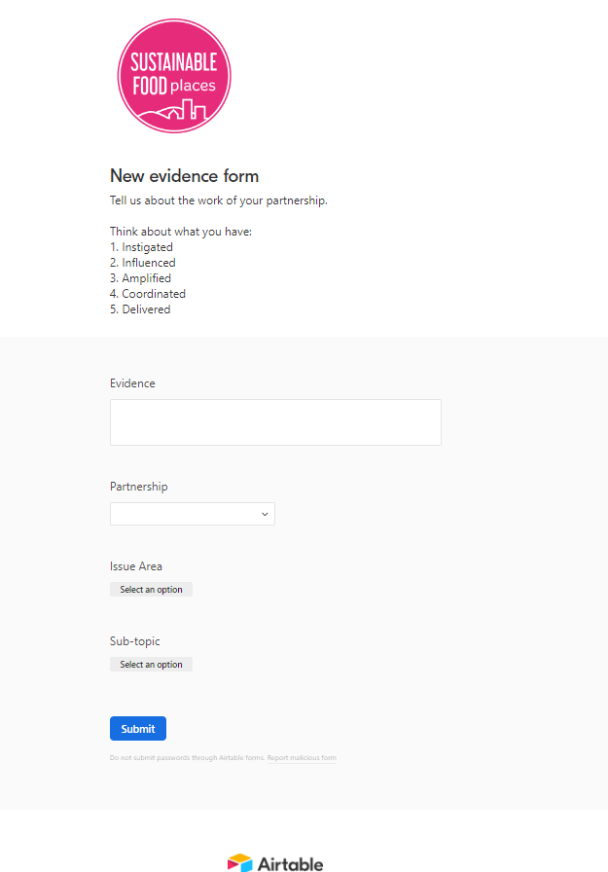
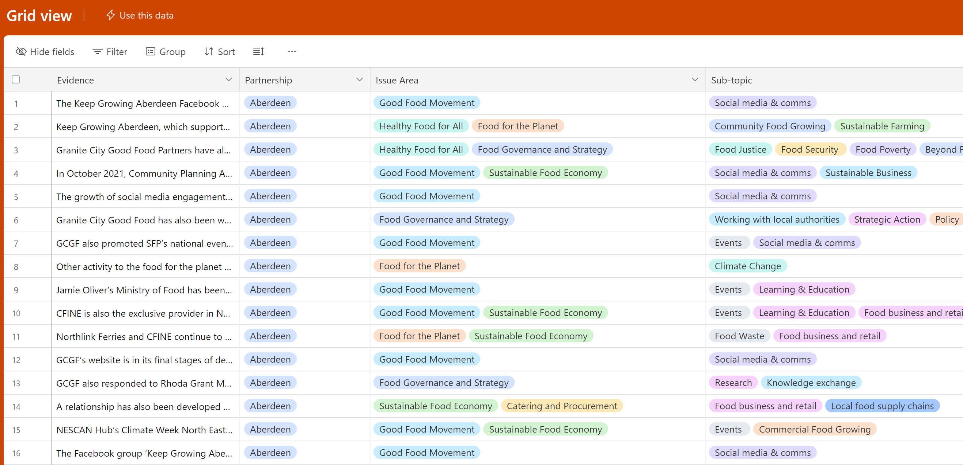
Create a database to log activity
Simple submission form for data collection
Automatically archived into database format
Click here to view the new SFP Evidence Database
or here for a guide to build your own.

Slide 21
Using your activity and impact data
Small activities may add up to big impact over time.
Data can be used to:
Document the role a food partnerships in the convening and coordinating the activities of partners.
Document the any recorded impacts of the partnership/partners.
Share knowledge of experience/good practice.
Visualise the scope and scale of the work of your partnership.
Provide a basis for analyzing the ripple effects of your actions.
Activity data provides the basis for the application of several rigorous non-experimental impact evaluation methodologies, such as:
Ripple Effect Mapping
Contribution Analysis
Innovation History
Outcome Harvesting
Outcome Mapping

Slide 22
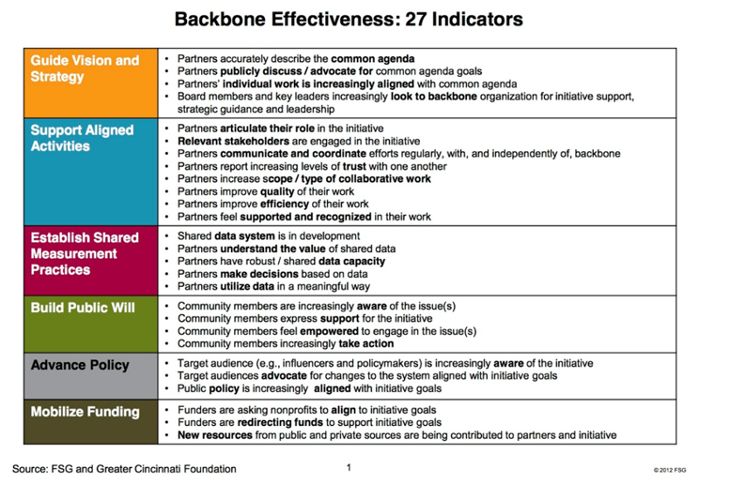
Evaluating your backbone effectiveness
https://collectiveimpactforum.org/resource/backbone-starter-guide-a-summary-of-major-resources-about-the-backbone/

Slide 23
Measuring Systems changes
Our work is about bringing about ‘systems-change’, but how do we evidence that we are achieving this?

Slide 24
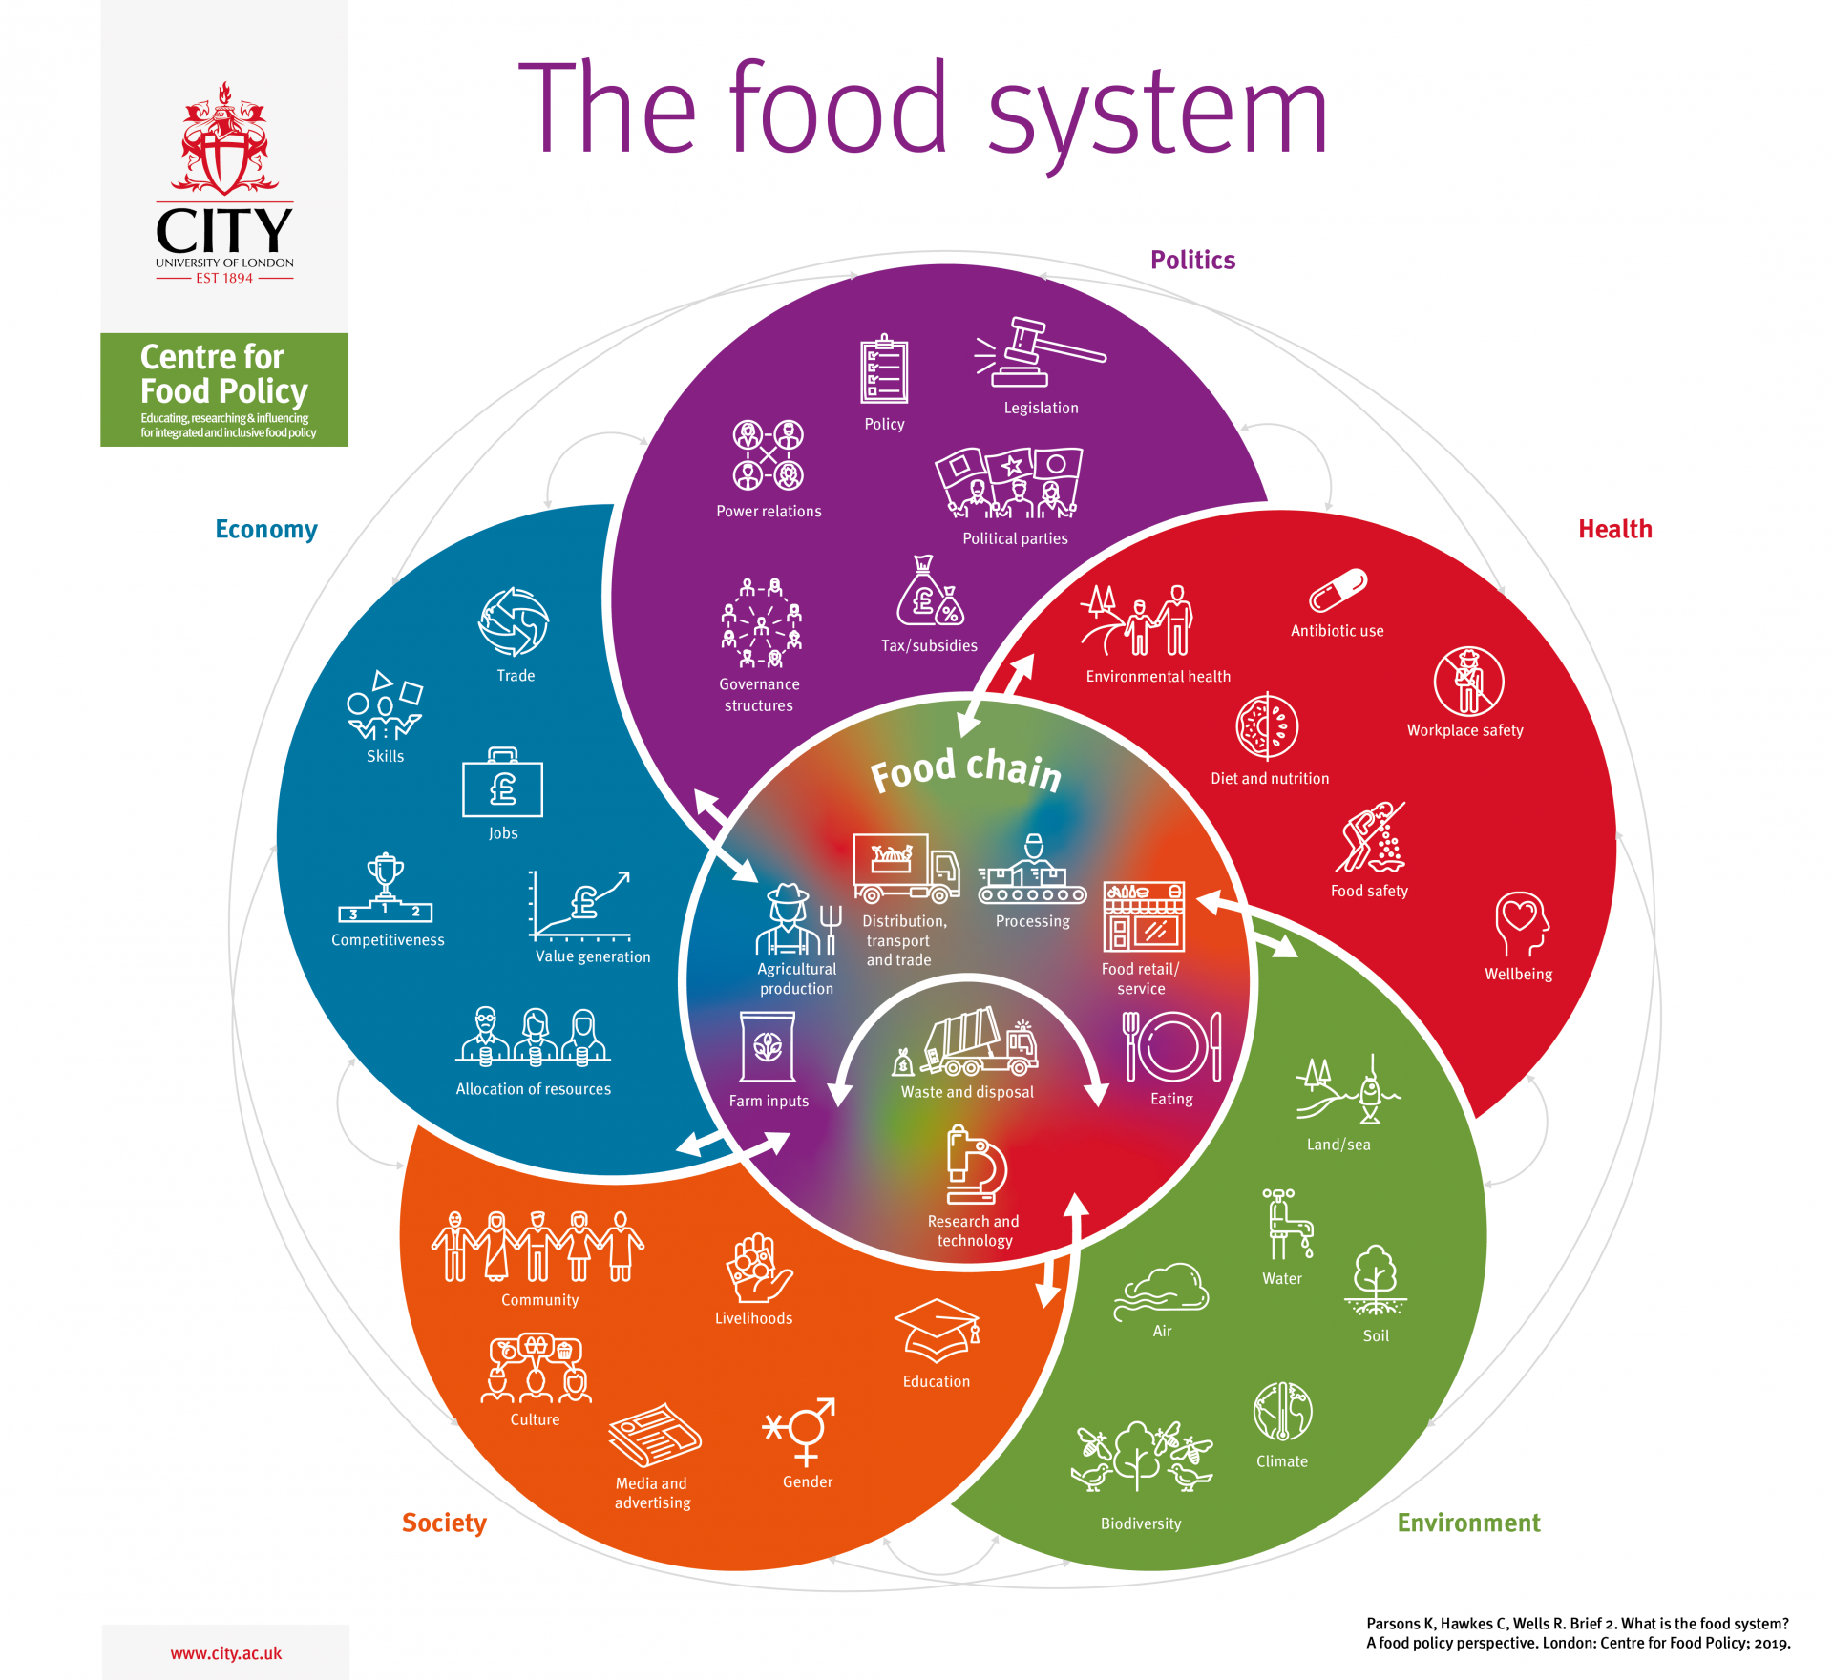
A food system comprises all the activities and outcomes involved in the production, transportation, marketing, distribution, consumption and disposal of food.
“The food system is the combination of all the elements - natural and man-made - that combine to produce, process, market and sell the food we eat and the connections between them” – National Food Strategy (2021)

Slide 25
Activities -> Outputs -> Outcomes -> Impact

Slide 26
What can we track and measure?
The outcomes of activities
The activities we engage in
Impact of our work
The outputs of our activities

Slide 27
Worked Example: Health
Impact goal: Improving physical and mental health and wellbeing by reducing food poverty; improving access to affordable healthy food; promoting healthy weight and healthy diets; and increasing participation in food related physical and social activity.
Measurable outcomes:
Decrease in the number of people requiring emergency food aid
Decrease in the number of people overweight or obese
Decrease in the number of people malnourished
Decrease in the consumption of salt, sugar, fat and meat
Increase in the consumption of fruit and vegetables (5 a day)
Increase in the number of healthy options in takeaways and vending
Increase in the availability of free drinking water
Increase in the number of people cooking with whole foods
Increase in number of people involved in community food activities

Slide 28
Proxy variables and levers for change
We may not have the capacity or ability to measure these changes. But we may be able to measure other things that give us an indication as to whether an outcome is more likely to happen.
Proxy variable: an indirect measure that can approximately represent a phenomenon without measuring it directly
‘if X happens, Y is also likely to happen’
Lever for change: an area of work that has the potential to deliver wide-ranging positive change beyond its immediate focus

Slide 29
Worked Example: Health
Proxy variables (levers for change):
A multi-agency partnership is established to strategically address the full range of issues that contribute to food poverty and health inequality.
Public and private sector organisations adopt healthy food policies including nutrition standards and healthy options in retail, catering and vending.
A range of healthy eating and healthy weight services are provided.
Public understanding of healthy eating issues are being raised through campaigns and other communication tools.
More healthy options are available in supermarkets, convenience stores, restaurants, etc.
Healthy Start vouchers, free school meals and other social food provision for vulnerable people are being provided and promoted.

Slide 30
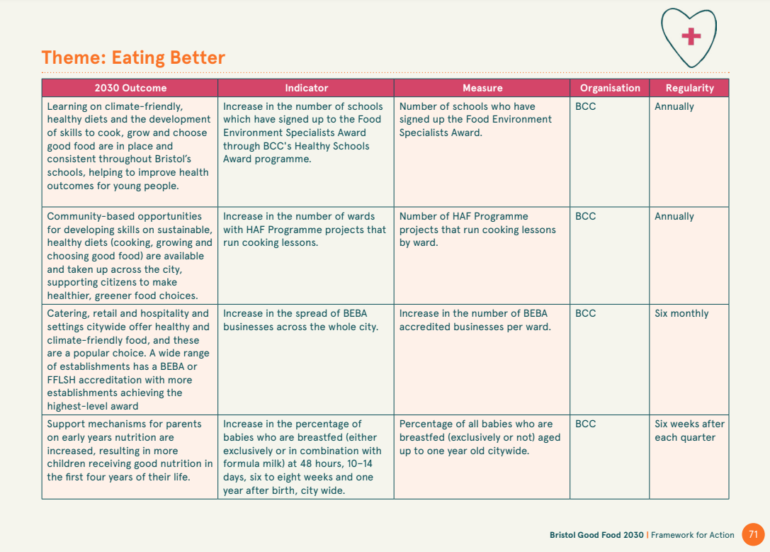
Bristol Good Food 2030: Key Performance Indicators

Slide 31
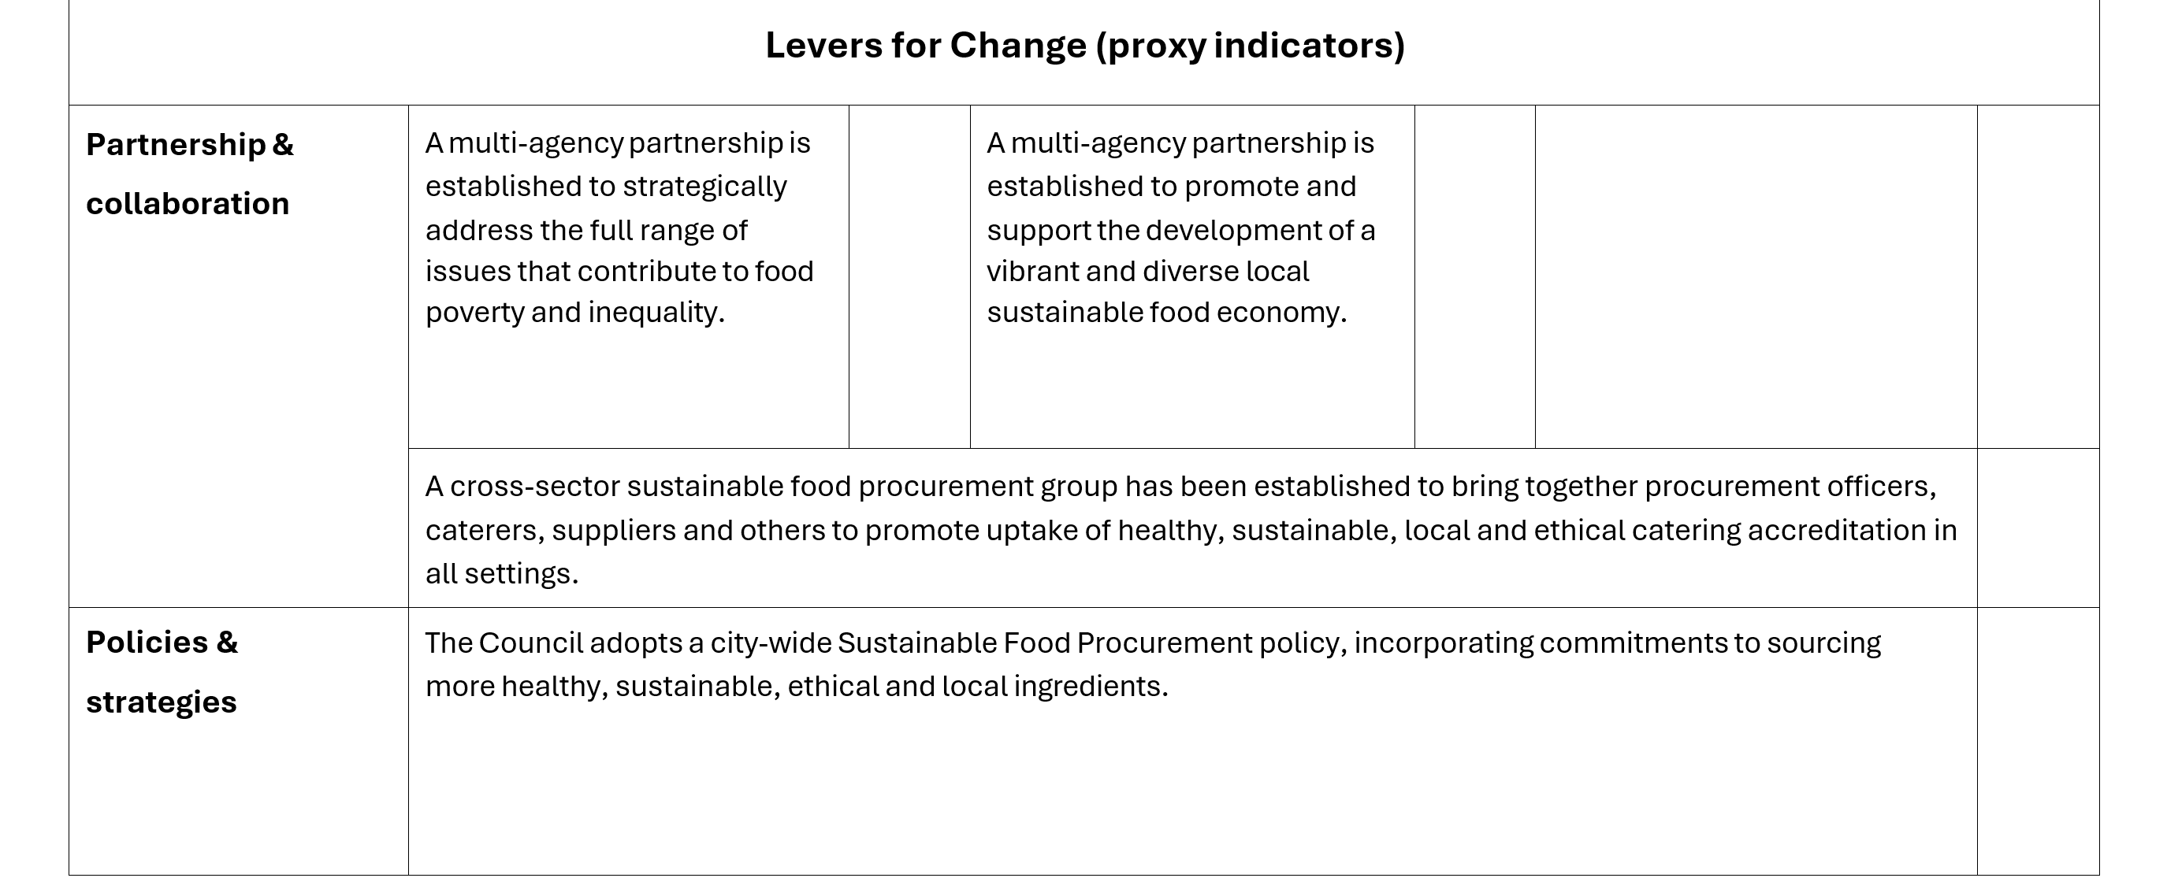
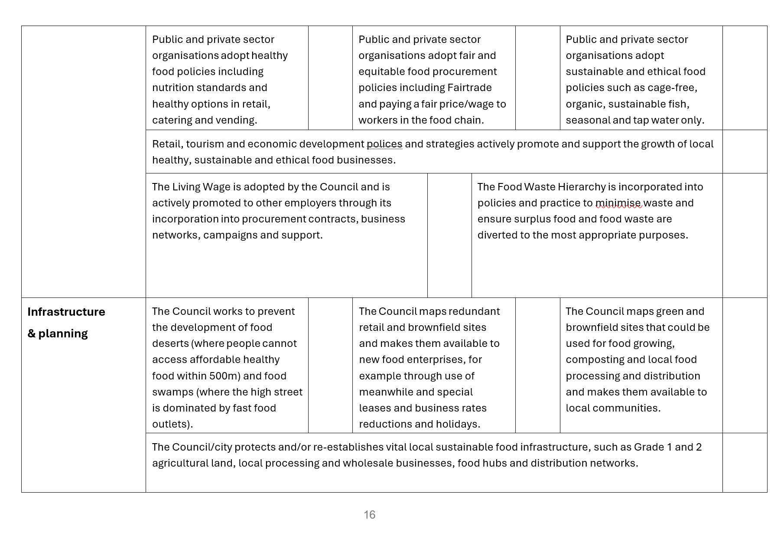
Sustainable Food Places – Levers for Change Indicators

Slide 32
Who collects the data?
You may not have the capacity or capability to collect all this information. But your partners might!
Examples of data sources:
Local Authority Health Profiles – Public Health England’s Local Authority Health Profile
Data on free school meals eligibility, uptake and nutritional standards compliance– Department of Education
Local authority environmental health reports – local authority websites
Food bank usage statistics – local community food providers
Local authority open data portals – local council websites
National Open Data Platforms – Government Data Portals (e.g., data.gov.uk)
Food partnerships can play a key coordinating role when it comes to collecting and consolidating data from partner organisations.

Slide 33
Gathering data from partners
Incentivize – communicate to your partners the value of submitting data to you. Make a case for how the data you collect will help amplify and support their work
Simplify – make data submission as quick and streamlined as possible. Create easy to use, non-time intensive systems for collecting and storing data.
Necessitate – add clear and accountable data expectations into partnership agreements.
Diversify - be open to diverse approaches to data collection including both quantitative and creative, qualitative methods.
Standardize – where quantitative data is concerned, it is good to agree standardized metrics across partners so that they can be easily compared and combined.

Slide 34
Addressing the twin attribution problem
Working in partnership –
Being clear about how food partnership add value (backbone function)
Tracking and logging your activity
Using that information to evidence the role that you have played in partner impact
Evidencing systems change –
Identifying (realistically) measurable outcomes and proxy indicators (levers for change).
Working with partners to measure and collect changes to system outcome
Playing a centralized coordination/consolidation role for data

Slide 35
Thanks! Any questions?

Slide 36
Further Reading
https://www.betterevaluation.org/getting-started/what-evaluation
https://www.betterevaluation.org/getting-started/choose-methods-processes
https://www.betterevaluation.org/frameworks-guides/rainbow-framework
https://www.ncvo.org.uk/help-and-guidance/strategy-and-impact/impact-evaluation/about-impact-and-evaluation/why-focus-on-impact-and-evaluation/?gad_source=1&gclid=CjwKCAjw5v2wBhBrEiwAXDDoJZz7D4caaih2vXzuCaAltn6LD8bvQI7lvABi8j-exby0r0MtbjQZ1xoC9eQQAvD_BwE
https://www.ncvo.org.uk/help-and-guidance/strategy-and-impact/impact-evaluation/about-impact-and-evaluation/why-focus-on-impact-and-evaluation/?gad_source=1&gclid=CjwKCAjw5v2wBhBrEiwAXDDoJZz7D4caaih2vXzuCaAltn6LD8bvQI7lvABi8j-exby0r0MtbjQZ1xoC9eQQAvD_BwE
https://policy-practice.oxfam.org/resources/a-quick-guide-to-monitoring-evaluation-accountability-and-learning-in-fragile-c-297134/
https://collectiveimpactforum.org/resource/backbone-starter-guide-a-summary-of-major-resources-about-the-backbone/

